Slide 1
BINGHAM UNIVERSITY • DEPARTMENT OF CYBER SECURITY
Corporate Incident Response Simulation
Technical Incident Report: Detection, Analysis, Containment and Recovery from SSH Brute-Force Attack
Analyst Role
Prepared By
Date
SOC Tier 1 Analyst
Moge Daniel Oluwadamilare (BHU/23/04/09/0079)
September 2026

Slide 2
Executive Summary
Simulated Lifecycle
Detection & SIEM
Rapid Containment
Modelled full SOC response lifecycle against a controlled, authorised SSH brute-force attack in an isolated virtual lab.
Host authentication logs ingested into Splunk Enterprise Free with network-layer corroboration via Wireshark tshark captures.
Compromise successfully mitigated using a host-based firewall UFW deny rule inserted at priority position 1.

Slide 3
Objective & Operational Scope
PRIMARY OBJECTIVE
Isolation Boundaries
Role-play SOC Analyst, Incident Lead, and Communications Officer across the complete incident-handling framework.
Confined entirely to VirtualBox Host-Only network (192.168.56.0/24).
Zero production systems or external third-party networks exposed.
ATTACK VECTOR
Unauthorised access via SSH credential brute-forcing against throwaway account testuser.
NAT adapters reserved strictly for baseline package installations.

Slide 4
Lab Environment & Tooling
VICTIM / SIEM NODE
ATTACKER NODE
Ubuntu Server
Kali Linux 2025.3
Host-only IP: 192.168.56.102
Host-only IP: 192.168.56.101
OpenSSH Server, Splunk Enterprise Free 10.2.0, UFW Firewall.
Hydra v9.7 (credential brute-forcer), Wireshark / Tshark packet capture.

Slide 5

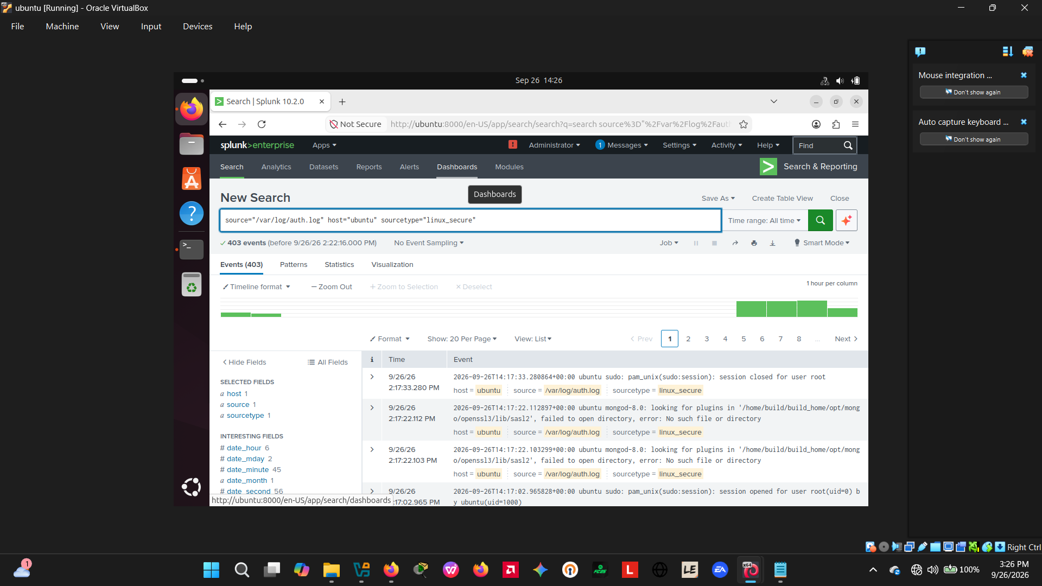
Methodology: Environment Verification
Interface addresses confirmed via ip on the Ubuntu victim VM, establishing host-only connectivity.
Splunk daemon verified active, with the web interface reachable at .
http://ubuntu:8000

Slide 6
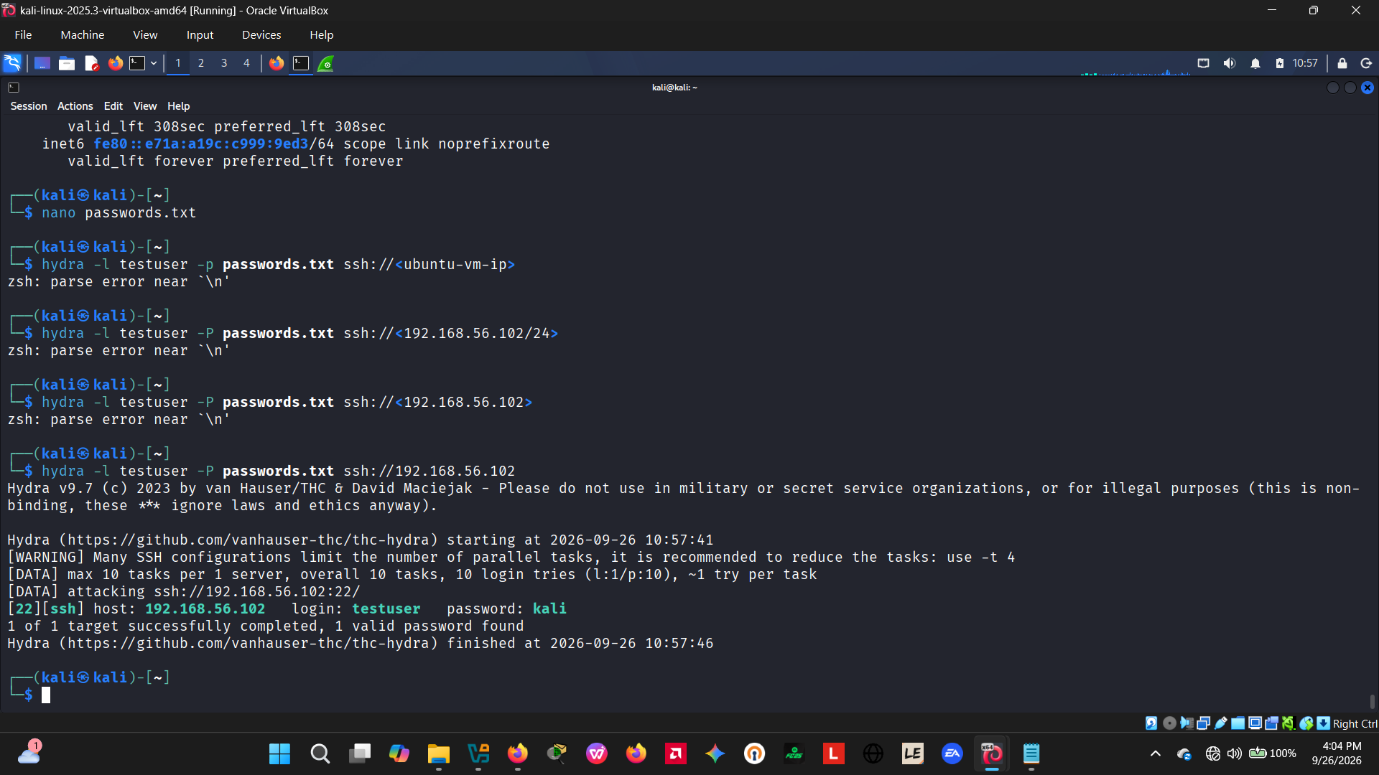
Attack Execution via Hydra
Custom password wordlist created on Kali VM containing candidate passwords alongside target .
kali
Hydra successfully executed against SSH port 22 of 192.168.56.102, recovering the valid credential pair .
testuser / kali

Slide 7
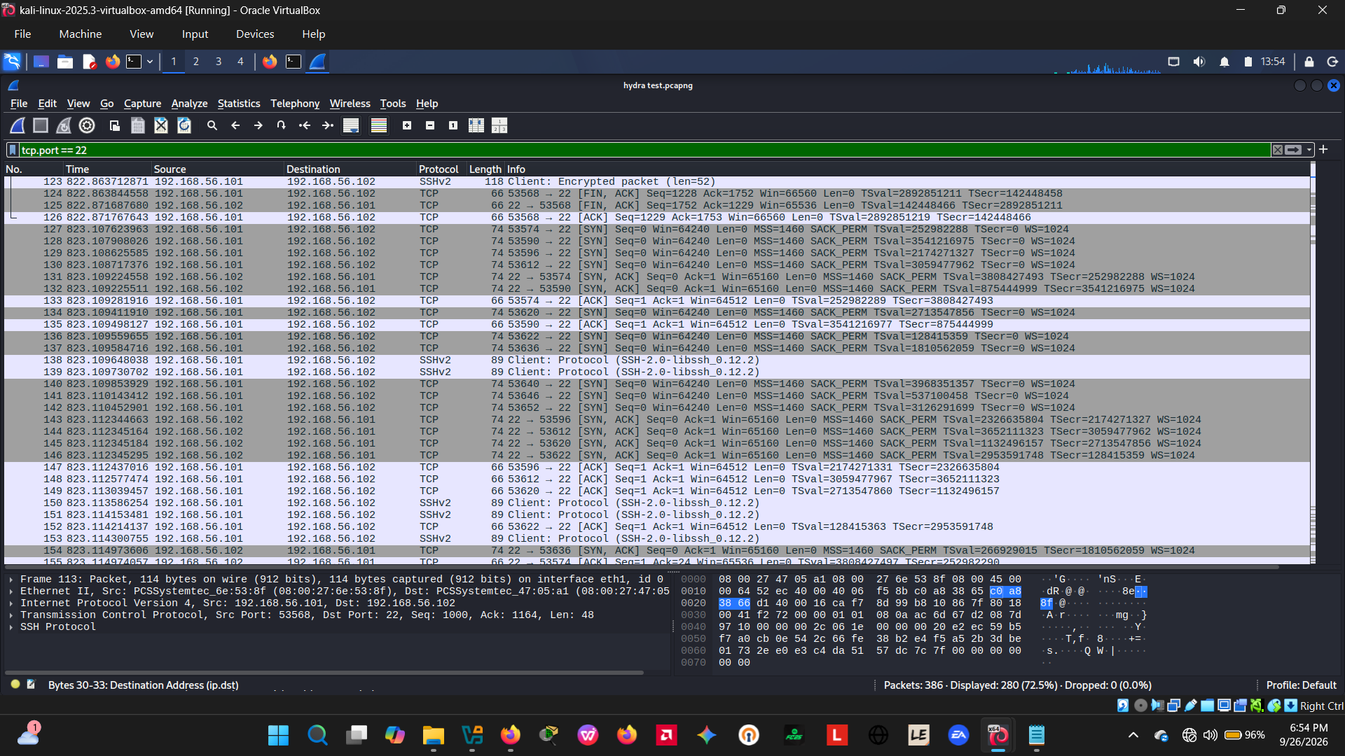
Network-Layer Analysis (Wireshark)
Packet capture filtered on confirms tcp.port == 22
rapid bursts of TCP 3-way handshakes.
Demonstrates the definitive network signature of automated brute-forcing followed by SSHv2 key exchange.

Slide 8
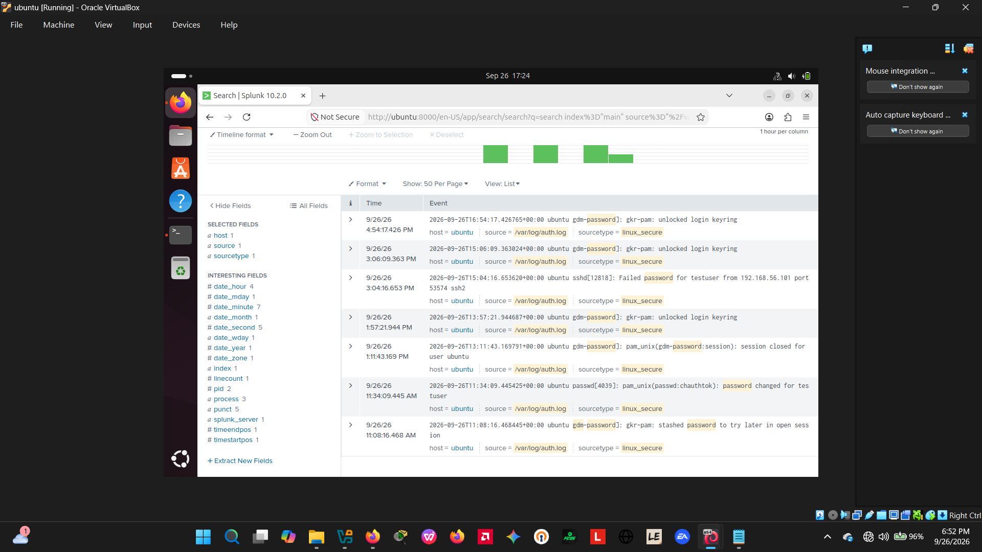
SIEM Detection & Log Ingestion
ingested into Splunk under .
/var/log/auth.log
sourcetype=linux_secure
Ad-hoc searches successfully isolated failed password events and confirmed five successful authentications for testuser.

Slide 9
Incident Timeline of Events
Pre-Attack
OpenSSH & Splunk configured; baseline auth.log verified clean.
14:17 – 14:33
Hydra brute-force executed against testuser; credential kali recovered.
15:04:14
First confirmed successful login recorded in auth.log & Wireshark capture.
18:00
Containment executed: UFW deny rule inserted at priority slot 1.

Slide 10
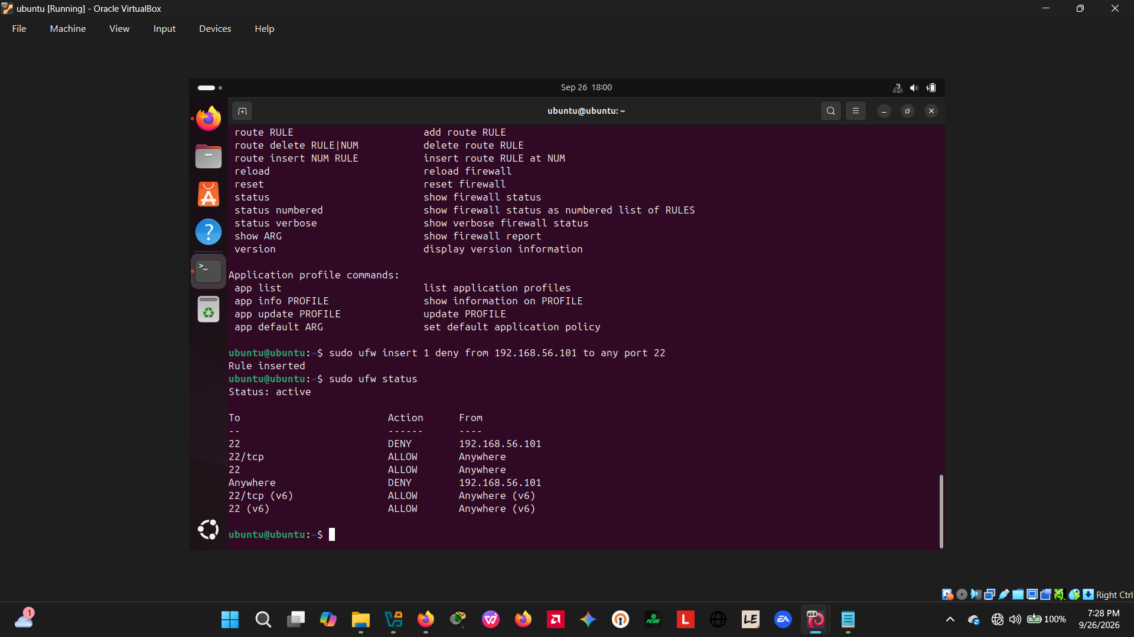
Containment Strategy & Verification
ACTION IMPLEMENTED
sudo ufw insert 1 deny from 192.168.56.101 to any port 22
Strategic Justification: Targeted IP-level block stops the attacker instantly without disrupting legitimate access from other sources or requiring service reboots.
Verification: UFW status confirmed active DENY rule evaluated ahead of general allow rules.

Slide 11
Key Findings & Recommendations
Root Vulnerabilities
Hardening Roadmap
Weak, easily-guessed password (kali).
Enforce SSH key-based authentication.
Absence of account lockout policies.
Deploy fail2ban for automated blocking.
Unrestricted connection rate limits.
Synchronize host clocks via NTP.

Slide 12
Conclusion & Q&A
Simulation successfully validated SOC detection capabilities, SIEM correlation, and rapid firewall mitigation against targeted brute-force incursions.

